Slide 1
Directed graph represented by adjacency matrix by using C program

Slide 2
Submitted by:
Tanvir Rahman
ID: 2022-3-60-134
M. Nura Alam Naim
ID: 2022-3-60-123
Mahamudur Rahman Maharaz
ID: 2022-3-60-182

Slide 3
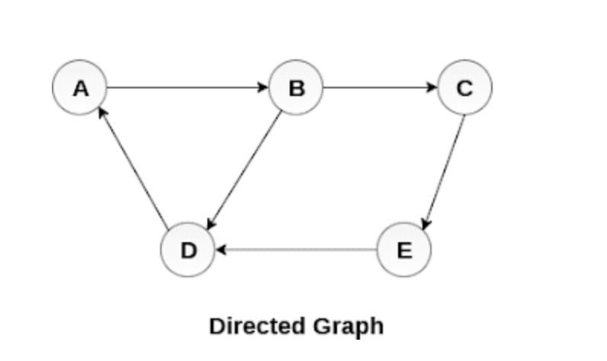
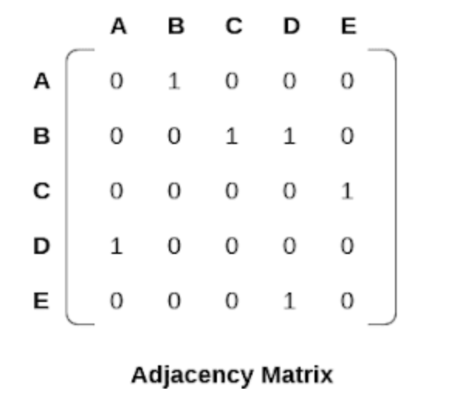
What is Directed Graph?
A directed graph, also called a digraph, is a graph in which the edges have a direction. This is usually indicated with an arrow on the edge.

Slide 4
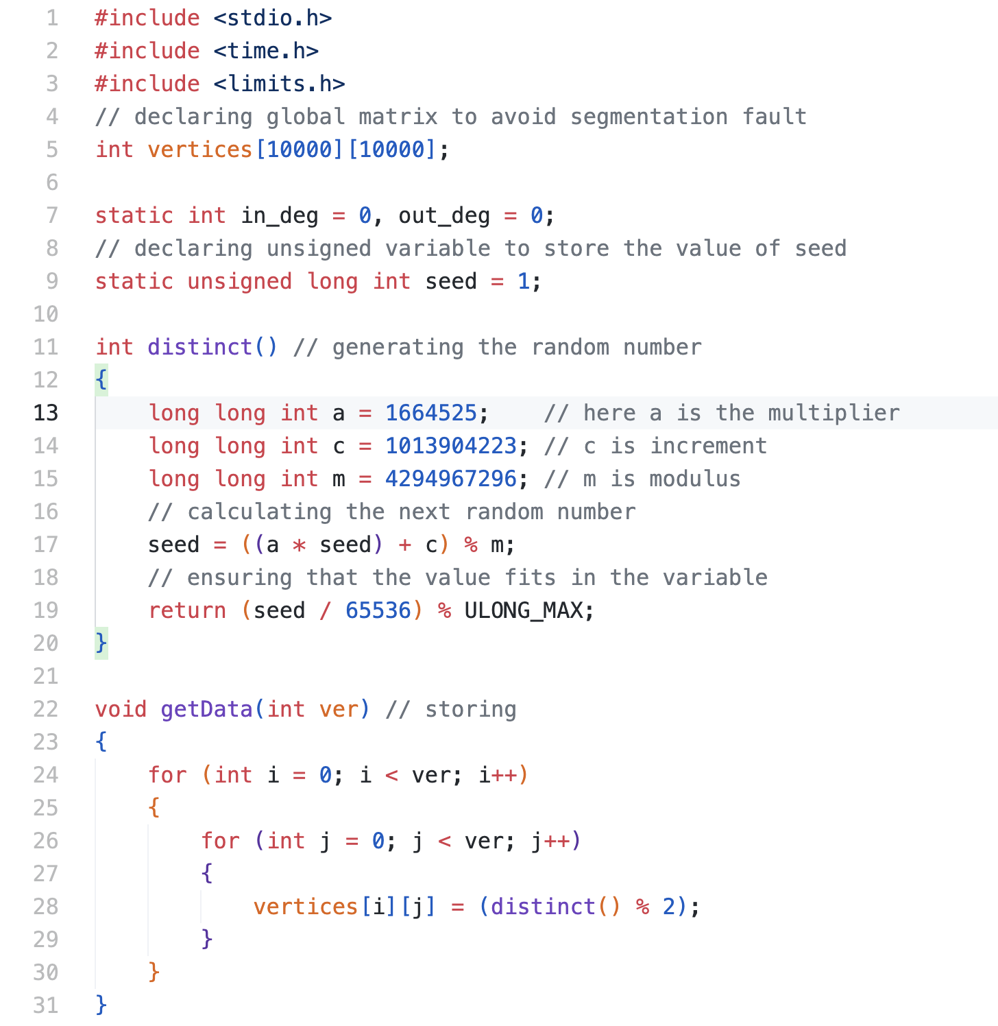
Source code

Slide 5
Source code

Slide 6
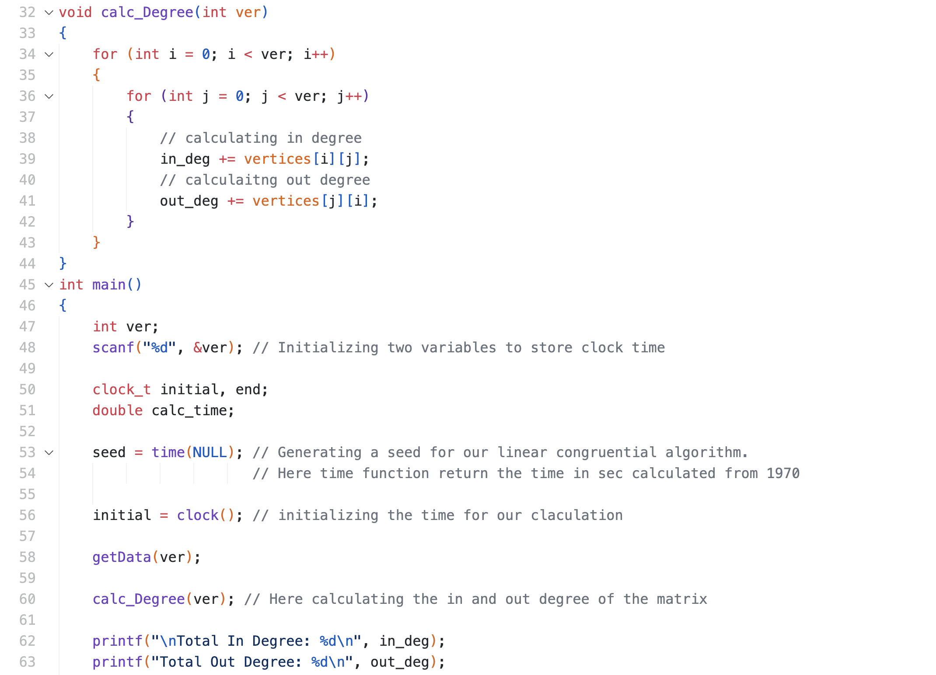
Source code

Slide 7
Source code

Slide 8
Source code

Slide 9
Source code

Slide 10
Source code

Slide 11
Source code

Slide 12
Source code

Slide 13
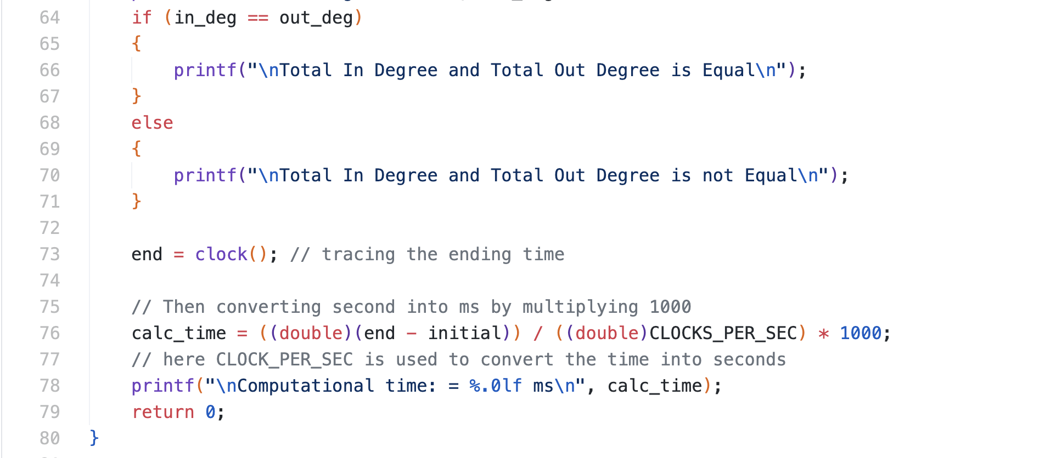
Source code

Slide 14
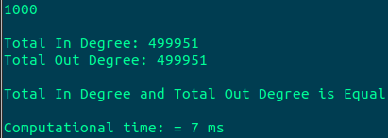
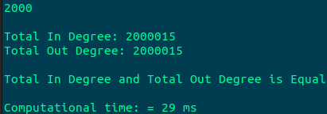
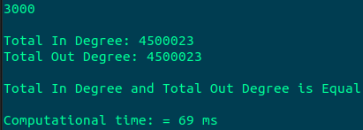
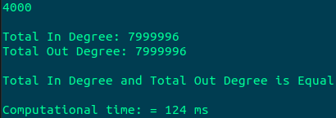
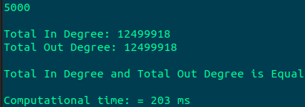
Source code

Slide 15
The Outputs of The Program
For No. Of vertices= 1000
For No. Of vertices= 2000
For No. Of vertices= 3000
For No. Of vertices= 4000
For No. Of vertices= 5000

Slide 16
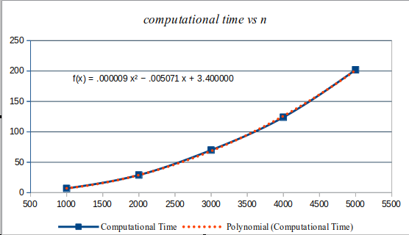
Graph

Slide 17
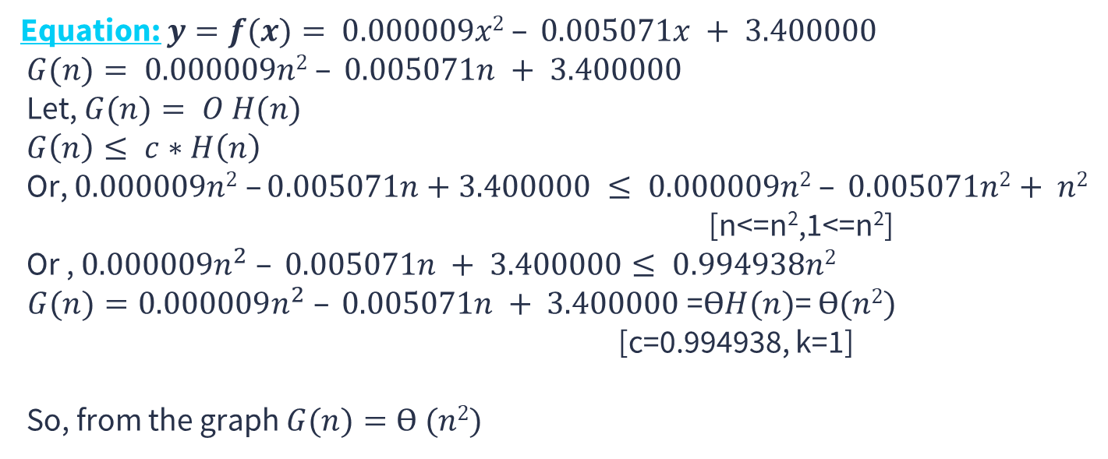
Equation from the Graph
Equation: $y=f(x)= 0.000009x2 – 0.005071x + 3.400000$
$G(n)= 0.000009n2 – 0.005071n + 3.400000$
Let, $G(n)= O H(n)$
$G\left(n\right)≤ c∗H\left(n\right)$
Or, $0.000009n2 –0.005071n+3.400000 ≤ 0.000009n2 – 0.005071n2+ n2$
[n<=n²,1<=n²]
Or , $0.000009n^{2} – 0.005071n + 3.400000≤ 0.994938n2$
$G(n)=0.000009n^{2} – 0.005071n + 3.400000$=$ӨH(n)$= $Ө(n2)$
[c=0.994938, k=1]
So, from the graph $G(n)=Ө (n2)$

Slide 18
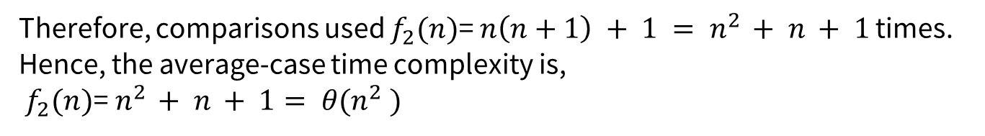
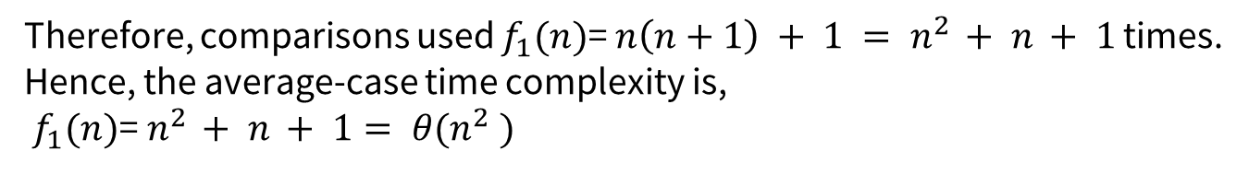
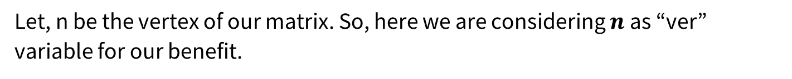
Theoretical time complexity of the program
Let, n be the vertex of our matrix. So, here we are considering $n$ as “ver” variable for our benefit.
[ loop in getdata() function ]
[ loop in calc_Degree() function ]
Therefore, comparisons used $f_{1}(n)$= $n\left(n+1\right) + 1 = n^{2 }+ n + 1$ times.
Hence, the average-case time complexity is,
${ f}_{1}(n)$=$n^{2 }+ n + 1= θ(n^{2} )$
Therefore, comparisons used $f_{2}(n)$= $n\left(n+1\right) + 1 = n^{2 }+ n + 1$ times.
Hence, the average-case time complexity is,
${ f}_{2}(n)$=$n^{2 }+ n + 1= θ(n^{2} )$

Slide 19
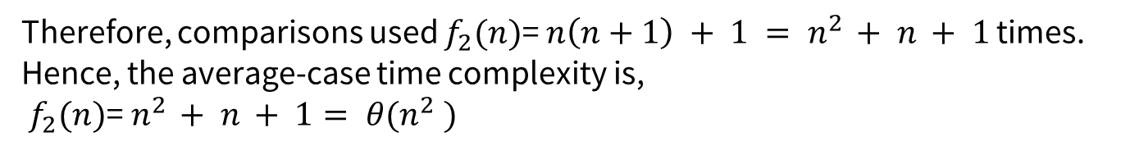
Theoretical time complexity of the program
Let, n be the vertex of our matrix. So, here we are considering $n$ as “ver” variable for our benefit.
[ loop in calc_Degree() function ]
[ loop in getdata() function ]
The average-time Complexity of the algorithm is,
${f\left(n\right)=f}_{1}+f_{2}$ $=n^{2 }+ n + 1+n^{2 }+ n + 1$ $=2n^{2}+2n+2$ $=Ө (n2)$
Therefore, comparisons used $f_{2}(n)$= $n\left(n+1\right) + 1 = n^{2 }+ n + 1$ times.
Hence, the average-case time complexity is,
${ f}_{2}(n)$=$n^{2 }+ n + 1= θ(n^{2} )$

Slide 20
Theoretical time complexity of the program
[ loop in getdata() function ]
[ loop in calc_Degree() function ]
The average-time Complexity of the algorithm is,
${f\left(n\right)=f}_{1}+f_{2}$ $=n^{2 }+ n + 1+n^{2 }+ n + 1$ $=2n^{2}+2n+2$ $=Ө (n2)$

Slide 21
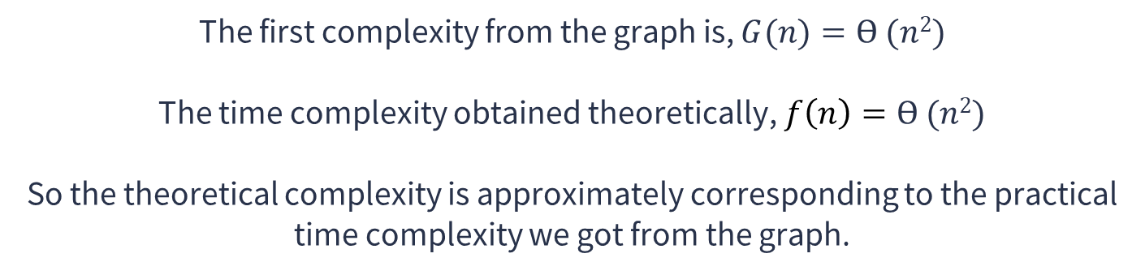
The relation between graph time and theoretical time complexity
The first complexity from the graph is, $G(n)=Ө (n2)$
The time complexity obtained theoretically,$f\left(n\right)=Ө (n2)$
So the theoretical complexity is approximately corresponding to the practical time complexity we got from the graph.

Slide 22
THANKS!

